Slide 1
SSZG 518: Database Design and Applications
Today’s Class
ER Modeling

Slide 2
Extended ER Features

Slide 3
Extended E-R Features: Specialization
Top-down design process; we designate subgroupings within an entity set that are distinctive from other entities in the set.
These subgroupings become lower-level entity sets that have attributes or participate in relationships that do not apply to the higher-level entity set.
Depicted by a triangle component labeled ISA (E.g., instructor “is a” person).
Attribute inheritance – a lower-level entity set inherits all the attributes and relationship participation of the higher-level entity set to which it is linked.

Slide 4
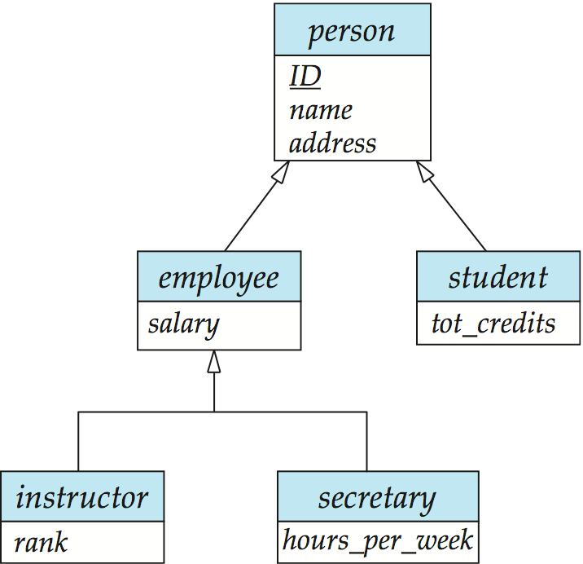
Specialization Example

Slide 5
Extended ER Features: Generalization
A bottom-up design process – combine a number of entity sets that share the same features into a higher-level entity set.
Specialization and generalization are simple inversions of each other; they are represented in an E-R diagram in the same way.
The terms specialization and generalization are used interchangeably.

Slide 6
Specialization and Generalization (Cont.)
Can have multiple specializations of an entity set based on different features.
E.g., permanent_employee vs. temporary_employee, in addition to instructor vs. secretary
Each particular employee would be
a member of one of permanent_employee or temporary_employee,
and also a member of one of instructor, secretary
The ISA relationship also referred to as superclass - subclass relationship

Slide 7
Design Constraints on a Specialization/Generalization
Constraint on which entities can be members of a given lower-level entity set.
condition-defined
Example: all customers over 65 years are members of senior-citizen entity set; senior-citizen ISA person.
user-defined
Constraint on whether or not entities may belong to more than one lower-level entity set within a single generalization.
Disjoint
an entity can belong to only one lower-level entity set
Noted in E-R diagram by having multiple lower-level entity sets link to the same triangle
Overlapping
an entity can belong to more than one lower-level entity set

Slide 8
Design Constraints on a Specialization/Generalization (Cont.)
Completeness constraint -- specifies whether or not an entity in the higher-level entity set must belong to at least one of the lower-level entity sets within a generalization.
total: an entity must belong to one of the lower-level entity sets
partial: an entity need not belong to one of the lower-level entity sets (default)

Slide 9
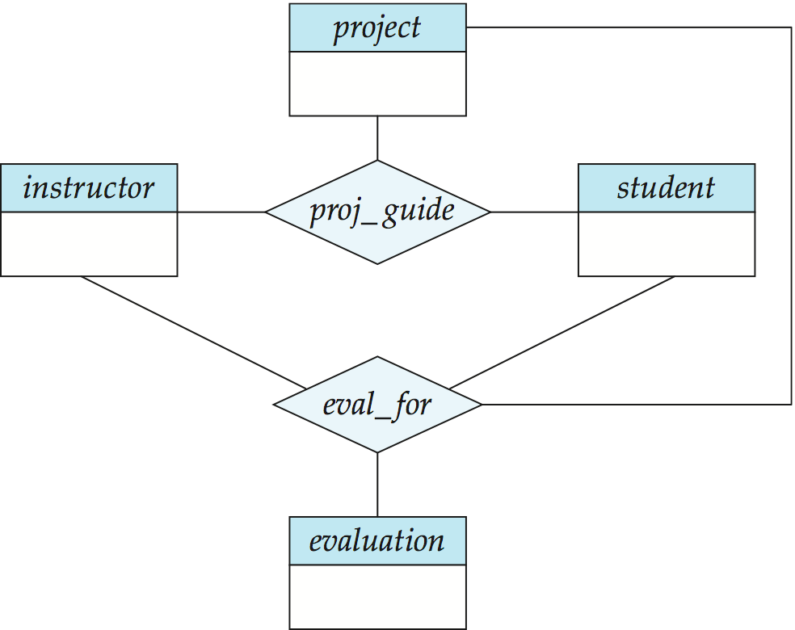
Aggregation
Consider the ternary relationship proj_guide, which we saw earlier
Suppose we want to record evaluations of a student by a guide on a project

Slide 10
Aggregation (Cont.)
Relationship sets eval_for and proj_guide represent overlapping information
Every eval_for relationship corresponds to a proj_guide relationship
However, some proj_guide relationships may not correspond to any eval_for relationships
So we can’t discard the proj_guide relationship
Eliminate this redundancy via aggregation
Treat relationship as an abstract entity
Allows relationships between relationships
Abstraction of relationship into new entity

Slide 11
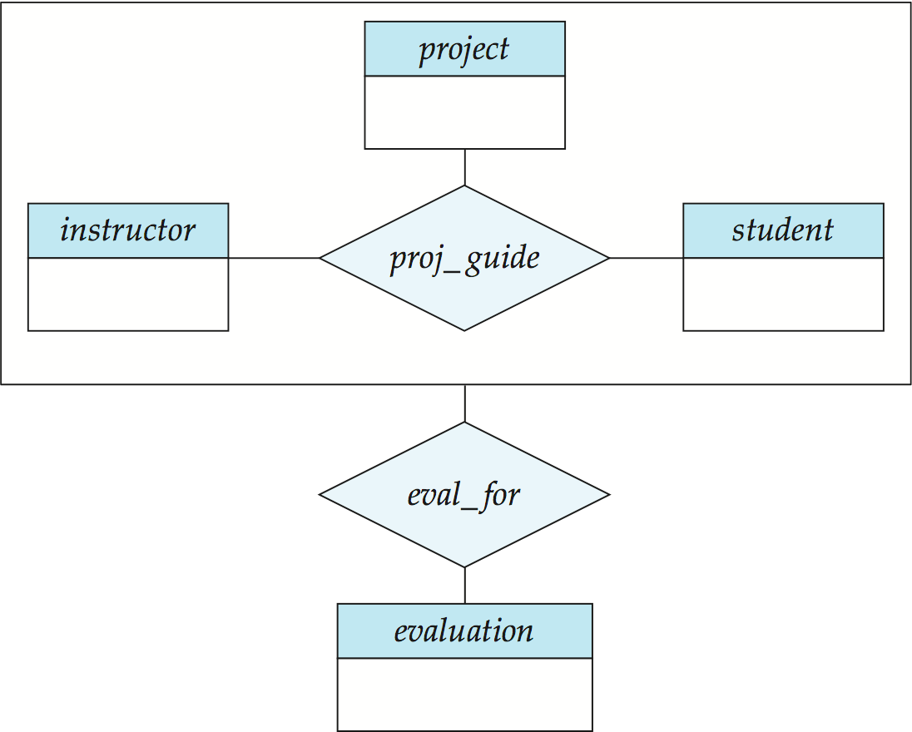
Aggregation (Cont.)
Without introducing redundancy, the following diagram represents:
A student is guided by a particular instructor on a particular project
A student, instructor, project combination may have an associated evaluation
Notes:
11

Slide 12
Aggregation
Relationship sets works_on and manages represent overlapping information
Every manages relationship corresponds to a works_on relationship
However, some works_on relationships may not correspond to any manages relationships
So we can’t discard the works_on relationship
Eliminate this redundancy via aggregation
Treat relationship as an abstract entity
Allows relationships between relationships
Abstraction of relationship into new entity
Without introducing redundancy, the following diagram represents:
An employee works on a particular job at a particular branch
An employee, branch, job combination may have an associated manager

Slide 13
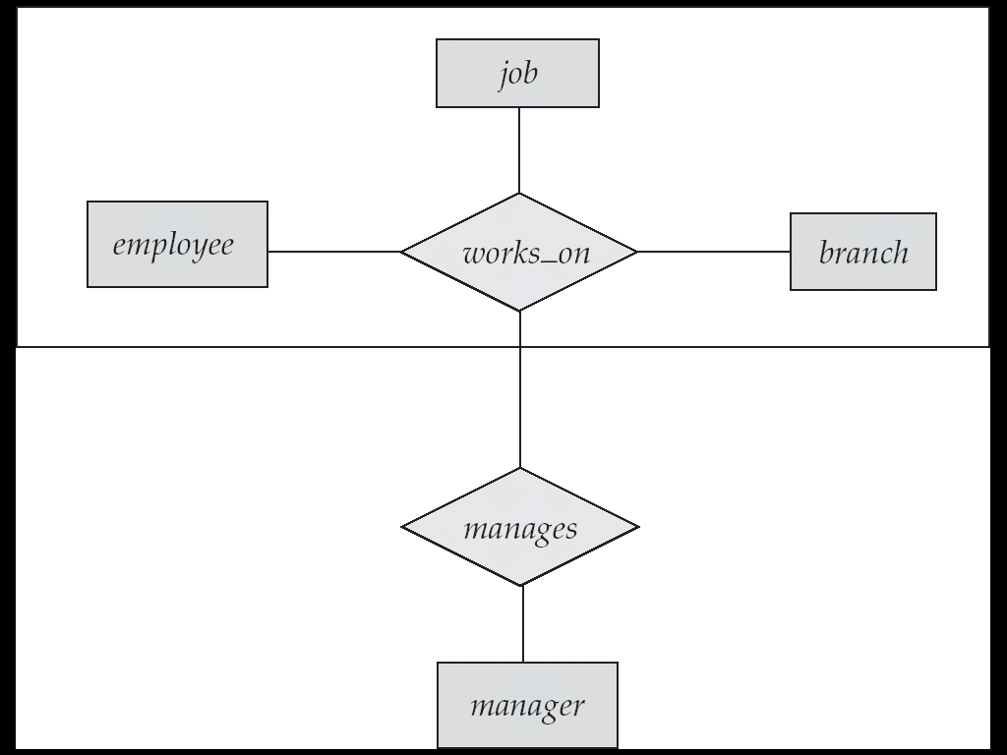
E-R Diagram With Aggregation

Slide 14
Aggregation
name
ssn
lot
Employees
Used when we have to model a relationship involving (entity sets and) a relationship set.
Aggregation allows us to treat a relationship set as an entity set for purposes of participation in (other) relationships.
Monitors
until
started_on
since
dname
pid
pbudget
did
budget
Projects
Sponsors
Departments
Aggregation vs. ternary relationship:
Monitors is a distinct relationship,
with a descriptive attribute.
Also, can say that each sponsorship
is monitored by at most one employee.
Notes:
2

Slide 15
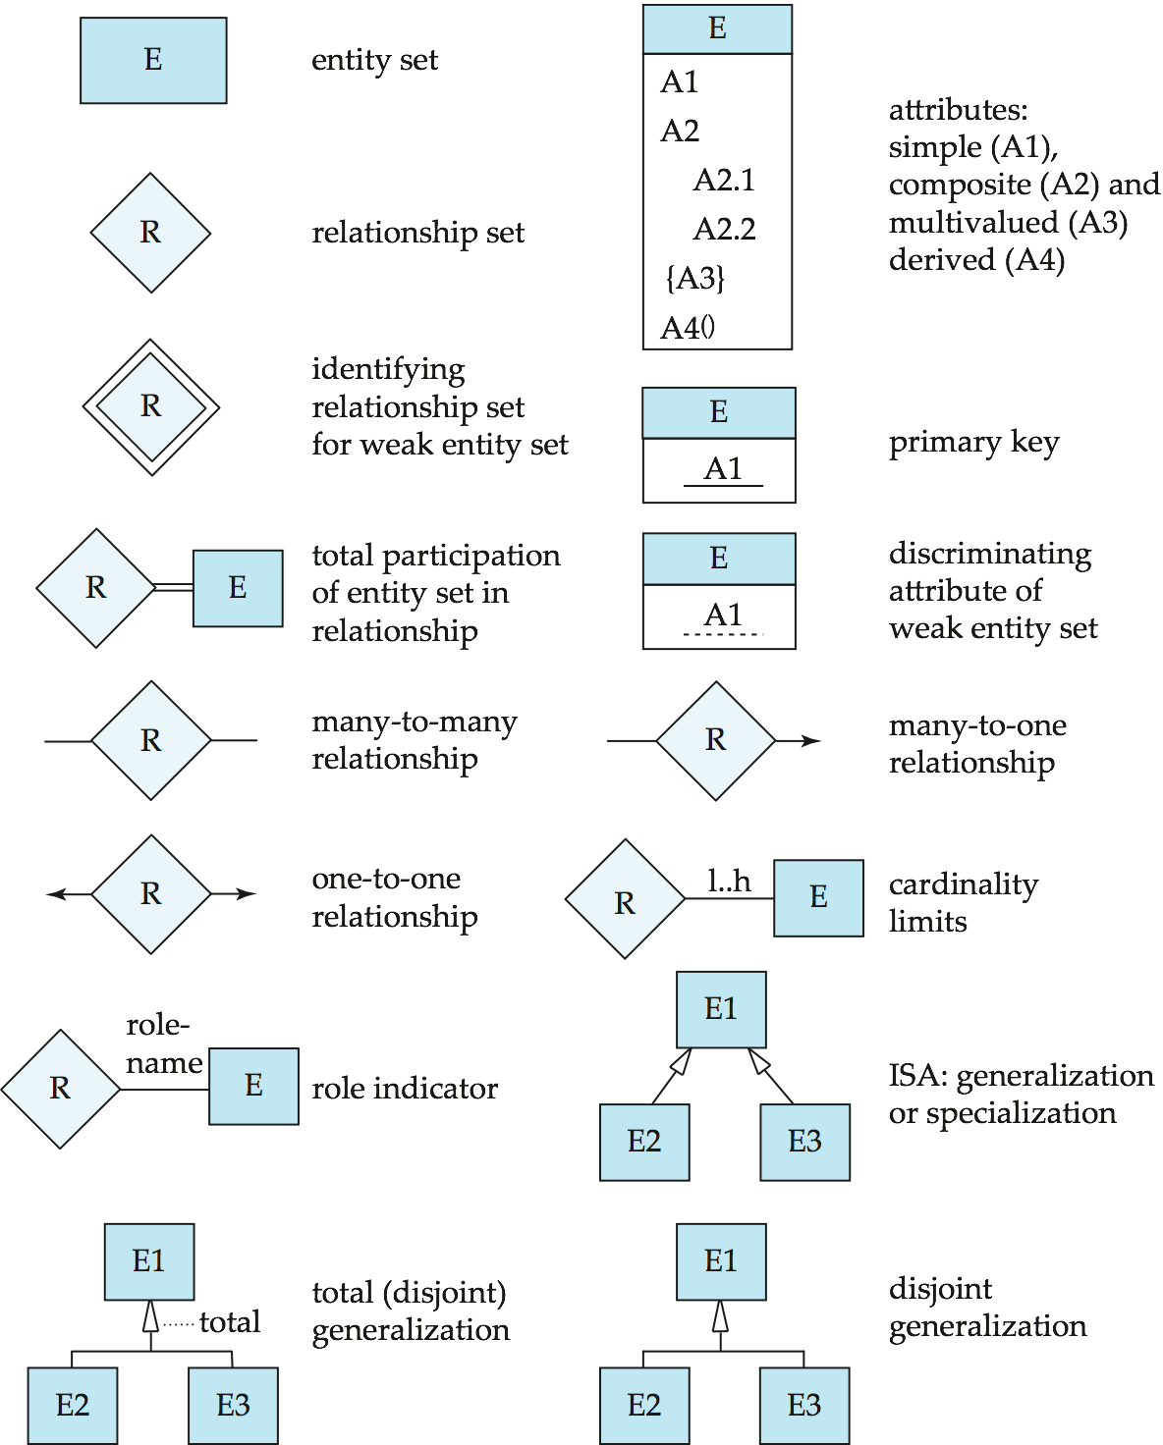
Summary of Symbols Used in E-R Notation

Slide 16
Symbols Used in E-R Notation (Cont.)

Slide 17
RELATIONSHIPS (Cont…)
Example: A library database contains a listing of authors that have written books on various subjects (one author per book). It also contains information about libraries that carry books on various subjects.
Entity sets: authors, subjects, books, libraries
Relationship sets: wrote, carry, indexed

Slide 18
RELATIONSHIPS (Cont…)
Subject
matter
title
isbn
SS#
authors
wrote
books
index
subject
name
carry
address
libraries

Slide 19
RELATIONSHIPS (Cont…)
Subject
matter
title
isbn
SS#
authors
wrote
books
index
subject
name
quantity
carry
address
libraries

Slide 20
E-R Design Decisions
The use of an attribute or entity set to represent an object.
Whether a real-world concept is best expressed by an entity set or a relationship set.
The use of a ternary relationship versus a pair of binary relationships.
The use of a strong or weak entity set.
The use of specialization/generalization – contributes to modularity in the design.
The use of aggregation – can treat the aggregate entity set as a single unit without concern for the details of its internal structure.

Slide 21
Conceptual Design Using the ER Model
Design choices:
Should a concept be modeled as an entity or an attribute?
Should a concept be modeled as an entity or a relationship?
Identifying relationships: Binary or ternary? Aggregation?
Constraints in the ER Model:
A lot of data semantics can (and should) be captured.
But some constraints cannot be captured in ER diagrams.
Notes:
3

Slide 22
Design Techniques
Avoid redundancy.
Limit the use of weak entity sets.
Don’t use an entity set when an attribute will do.

Slide 23
Valid E/R Diagrams
An E/R diagram is valid if and only if:
It is syntactically correct (e.g. specifies all key constraints,…)
It specifies the entity types, relationship types, attribute types, and subtype relationships necessary to satisfy all information requirements.
It does not specify any invalid constraints.

Slide 24
Priorities when Choosing Between Valid E/R Diagrams
Express all constraints (you can express!)
Use and do not change terminology and class structure of the application domain
Keep it simple (avoid defining entity types that do not serve any purpose)
Avoid redundancy (but derived attributes are okay)!

Slide 25
E/R Diagram Design – Typical Errors
Missing Constraints
Unexpressed Constraints due to bad design
Every entity type needs a key
Attribute associated with the wrong entity type (relationship type)
Relationships are sets!
No partial participation in relationships!
Missing existence dependencies (use subclasses)
Invalid constraints
Using Subtypes for n:1 relationships; using relationships when subtypes should be used.
When defining relationships: Too general entity types for participating entities
Too many entity types
Using foreign keys instead of relationships

Slide 26
Other Issues in E/R Design
No relationships of relationships --- solution: create an entity type that represent instances of the relationship (or use aggregation as discussed in the textbook)
value or entity type --- solution: choose entity type if it helps expressing constraints; otherwise, use value-type.

Slide 27
A University Database
Design an entity-relationship diagram that describes the following objects in a university application: students, professors, and courses. Students take a course in a particular semester and receive a grade for their performance. Sometimes students take the same course again in different semester. There are no limits on how many courses a student can take, and on how many students completed a particular course. Each student has exactly one advisor, who must be a professor, whereas each professor allowed being the advisor of at most 20 students. Courses have a unique course number and a course title. Students and professors have a name and a unique SSN. Students additionally have a GPA and a single or multiple major.

Slide 28
A movie studio might have several film crews. The crews might be designated by a given studio as crew 1, crew 2, and so on. However, other studios might use the same designations for crews, so the attribute number is not a key for crews. Rather, to name a crew uniquely, we need to give both the name of the studio to which it belongs and the number of crew. The key for the weak entity set Crews is its own number attribute and the name attribute of the unique studio to which the crew is related by the many-one Unit-of relationship.

Slide 29
Exercise 2.4 A company database needs to store information about employees (identified by ssn, with salary and phone as attributes), departments (identified by dno, with dname and budget as attributes), and children of employees (with name and age as attributes). Employees work in departments; each department is managed by an employee; a child must be identified uniquely by name when the parent (who is an employee; assume that only one parent works for the company) is known. We are not interested in information about a child once the parent leaves the company. Draw an ER diagram that captures this information.

Slide 30
Summary of Conceptual Design
Conceptual design follows requirements analysis,
Yields a high-level description of data to be stored
ER model popular for conceptual design
Constructs are expressive, close to the way people think about their applications.
Note: There are many variations on ER model
Both graphically and conceptually
Basic constructs: entities, relationships, and attributes (of entities and relationships).
Some additional constructs: weak entities, ISA hierarchies, and aggregation.
Notes:
11

Slide 31
Summary of ER (Cont.)
Several kinds of integrity constraints:
key constraints
participation constraints
overlap/covering for ISA hierarchies.
Some foreign key constraints are also implicit in the definition of a relationship set.
Many other constraints (notably, functional dependencies) cannot be expressed.
Constraints play an important role in determining the best database design for an enterprise.
Notes:
12

Slide 32
Summary of ER (Cont.)
ER design is subjective. There are often many ways to model a given scenario!
Analyzing alternatives can be tricky, especially for a large enterprise. Common choices include:
Entity vs. attribute, entity vs. relationship, binary or n-ary relationship, whether or not to use ISA hierarchies, aggregation.
Ensuring good database design: resulting relational schema should be analyzed and refined further.
Functional Dependency information and normalization techniques are especially useful.
Notes:
13

